Slide 1
Reddit Sentiment Analysis #4 Sentiment Analysis // Azure
-Submitted by:- Mandeep singh sawhney
-Student id:- 200557021

Slide 2
#1. Tools Used
Data Source: Reddit
Data Storage: Azure Blob Storage
Data Ingestion: Azure Data Factory
Database: SQL Server
Visualization: PowerBI

Slide 3
#2. Project Architecture
Data Collection: Scraping data from Reddit and saving it as a CSV file.
Data Storage: Uploading the CSV file to Azure Blob Storage.
Data Ingestion: Using Azure Data Factory (ADF) to move data from Blob Storage to SQL Server.
Data Visualization: Creating dashboards in PowerBI.

Slide 4
#3. Libraries Used
-For data scraping from reddit and then cleaning the data
from IPython import display
import math
from pprint import pprint
import pandas as pd
import numpy as np
import nltk
import matplotlib.pyplot as plt
import seaborn as sns
sns.set(style='darkgrid', context='talk', palette='Dark2')

Slide 5
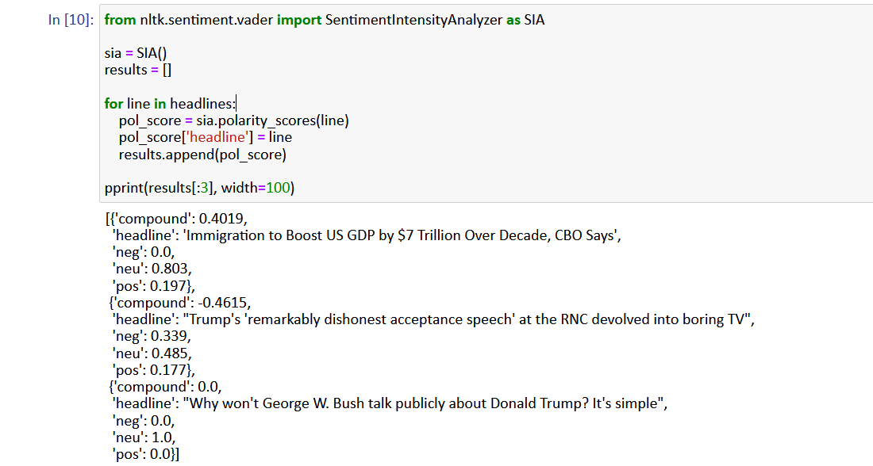
Libraries Used Contd..
Data Collection
Data Source: Reddit
Method: Web scraping using Python libraries (PRAW)
Output: CSV file containing scraped data.
Sentiment Analysis
Library used is SentimentIntensityAnalyzer from Vader Module.

Slide 6
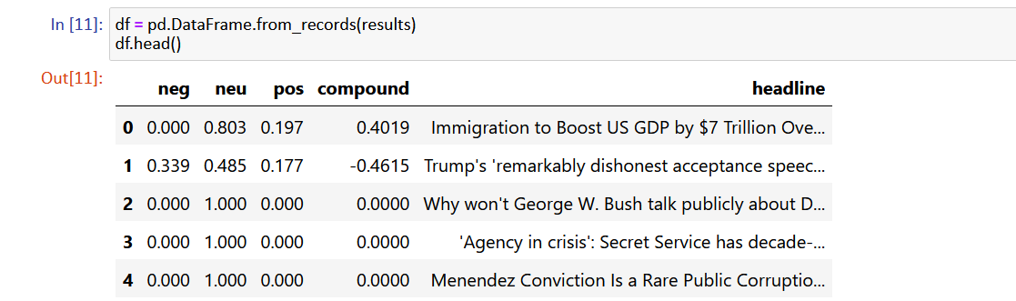
Libraries Used Contd..
After this we get negative, neutral, compound and positive classification for our headlines.

Slide 7
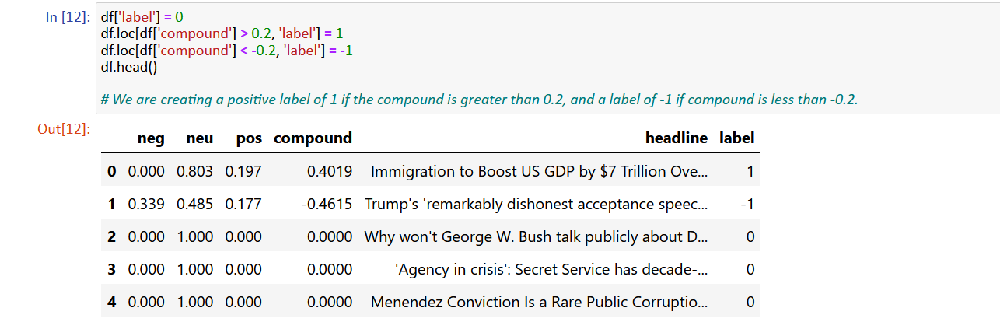
Libraries Used Contd..
# Now to simplify analysis we give positive label of 1 if the compound is greater than 0.2, and a label of -1 if compound is less than -0.2. So now we finally get our news segregated with 0,1,-1 and our dataset is ready for further analysis.

Slide 8
API SETUP, DATA SCRAPE AND SAVING CSV FILE SCREENSHOTS

Slide 9
Data collection Phase – I am sourcing data from Reddit (Politics news) Reddit connection through API

Slide 10
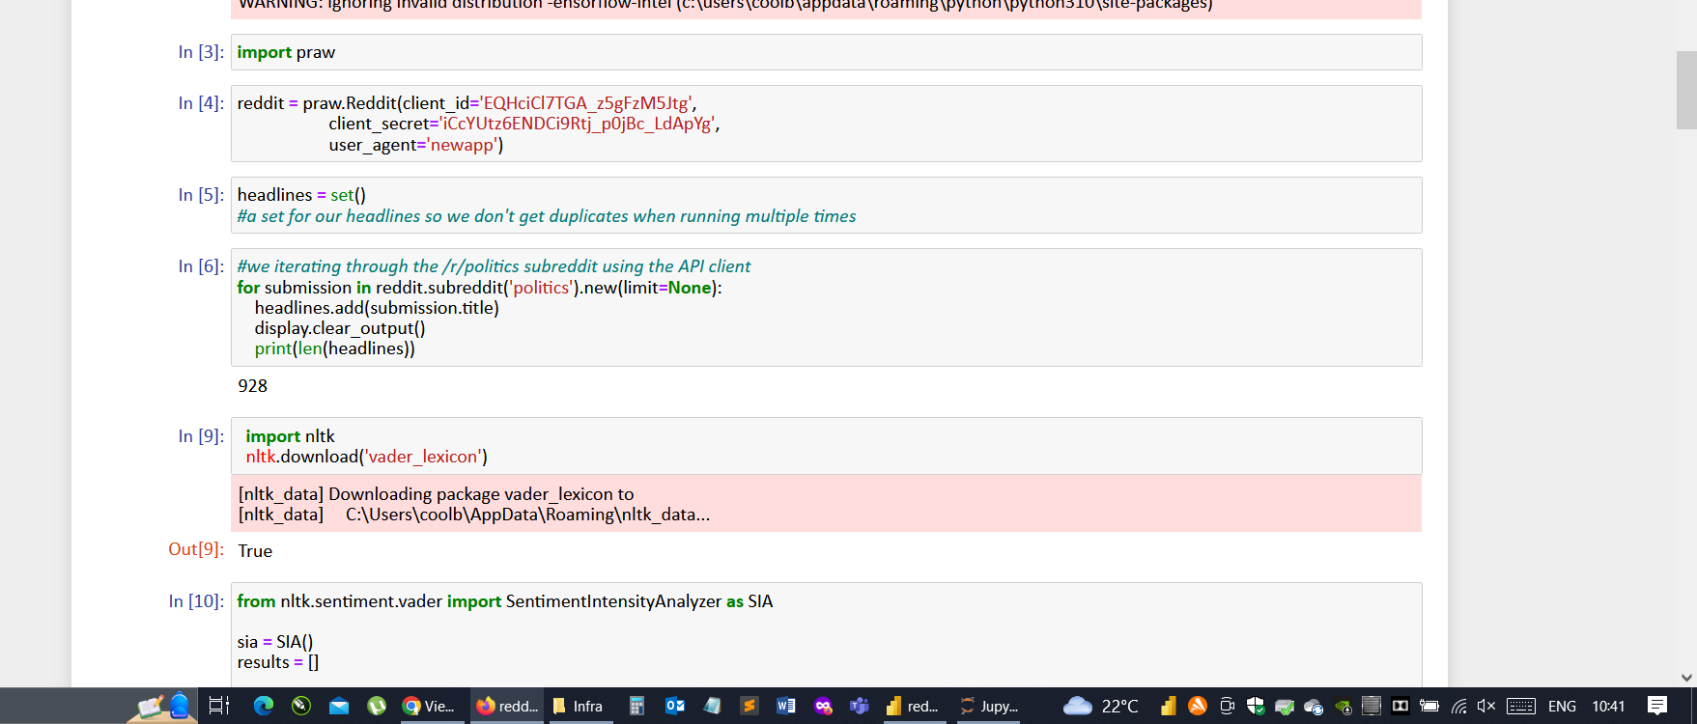
Step 1: Reddit connection through API

Slide 11
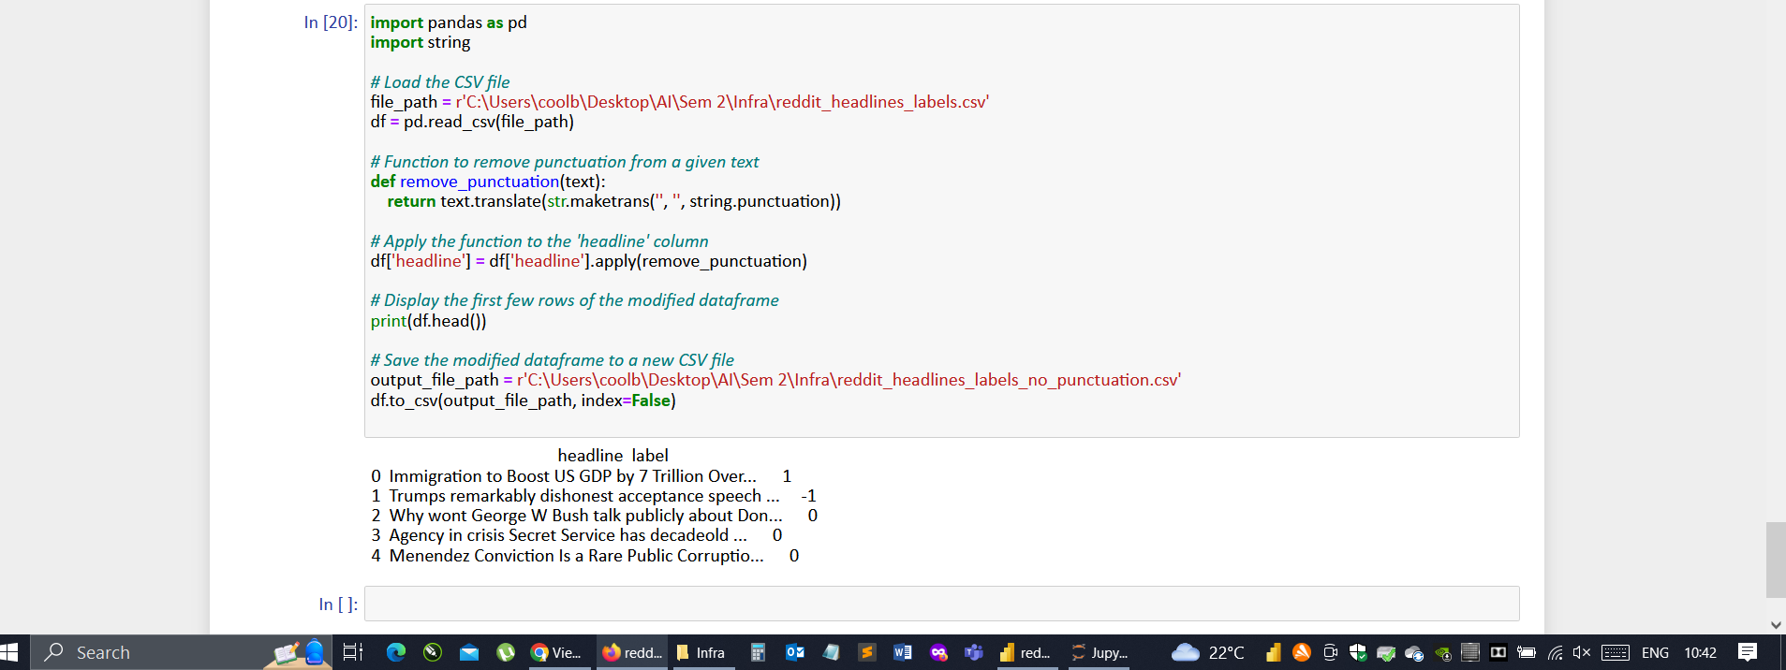
Step 2: Data Cleaning (Removing Punctuations)

Slide 12
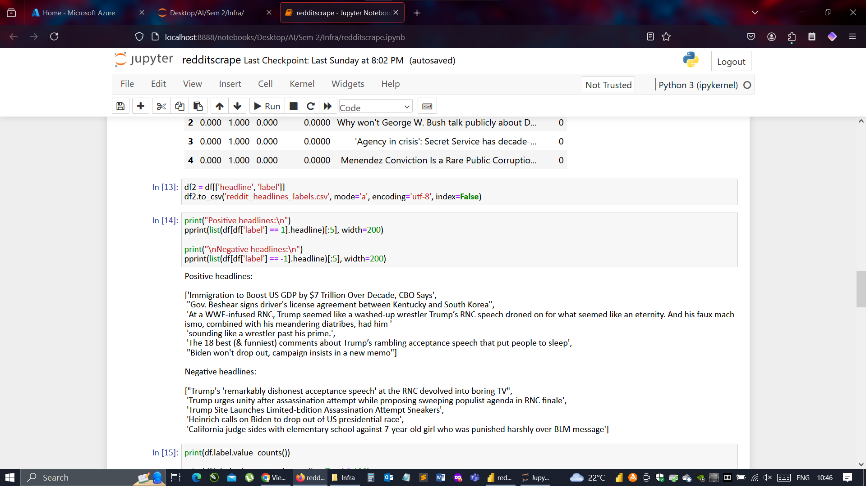
Saving CSV file to continue with next steps

Slide 13
#4. Data Storage
Data Storage Service: Azure Blob Storage
Steps:
Created a storage account on Azure.
Created a container within the storage account.
Uploaded the CSV file to the container.

Slide 14
UPLOADING THE SAVED CSV FILE TO AZURE BLOB STORAGE SCREENSHOT

Slide 15
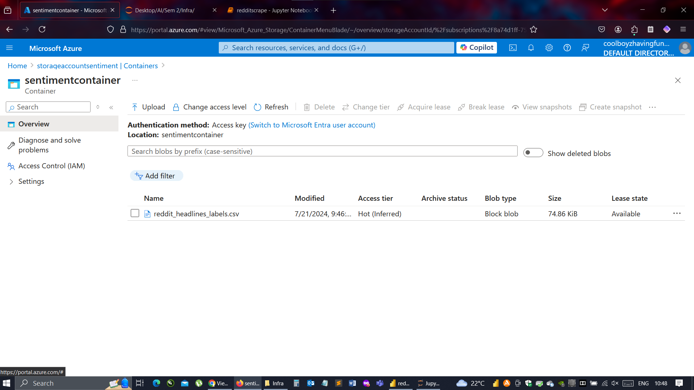
Screenshot of the csv file uploaded in the sentiment container(blob storage)

Slide 16
#5. Data Ingestion
Data Ingestion Service: Azure Data Factory (ADF)
Steps:
Create a pipeline in ADF.
Configured the pipeline to read data from Blob Storage.
Set up the destination as SQL Server.
Ran the pipeline to transfer data.

Slide 17
CREATION OF DATA FACTORY AND PIPELINE TO FEED THE SQL DATABASE SCREENSHOTS

Slide 18
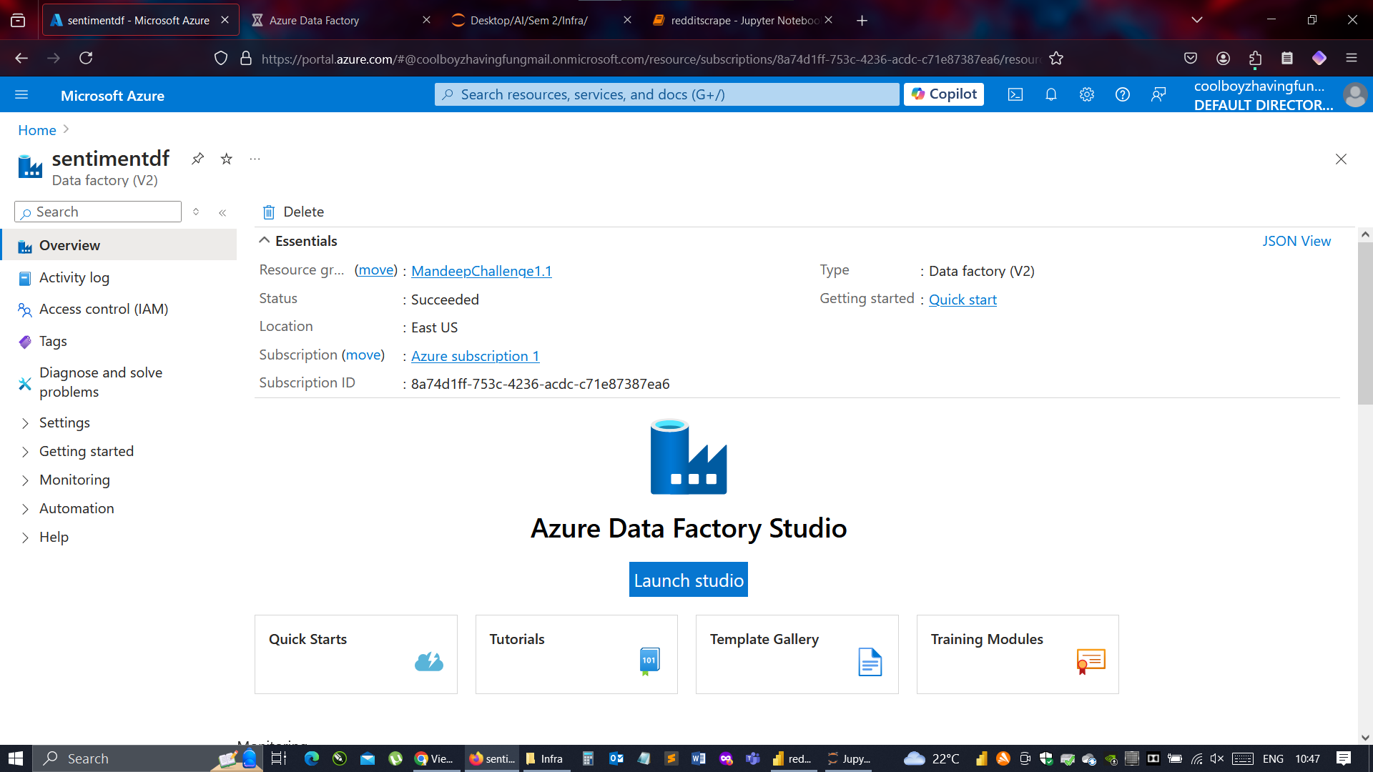
Screenshot of the base data factory creation

Slide 19
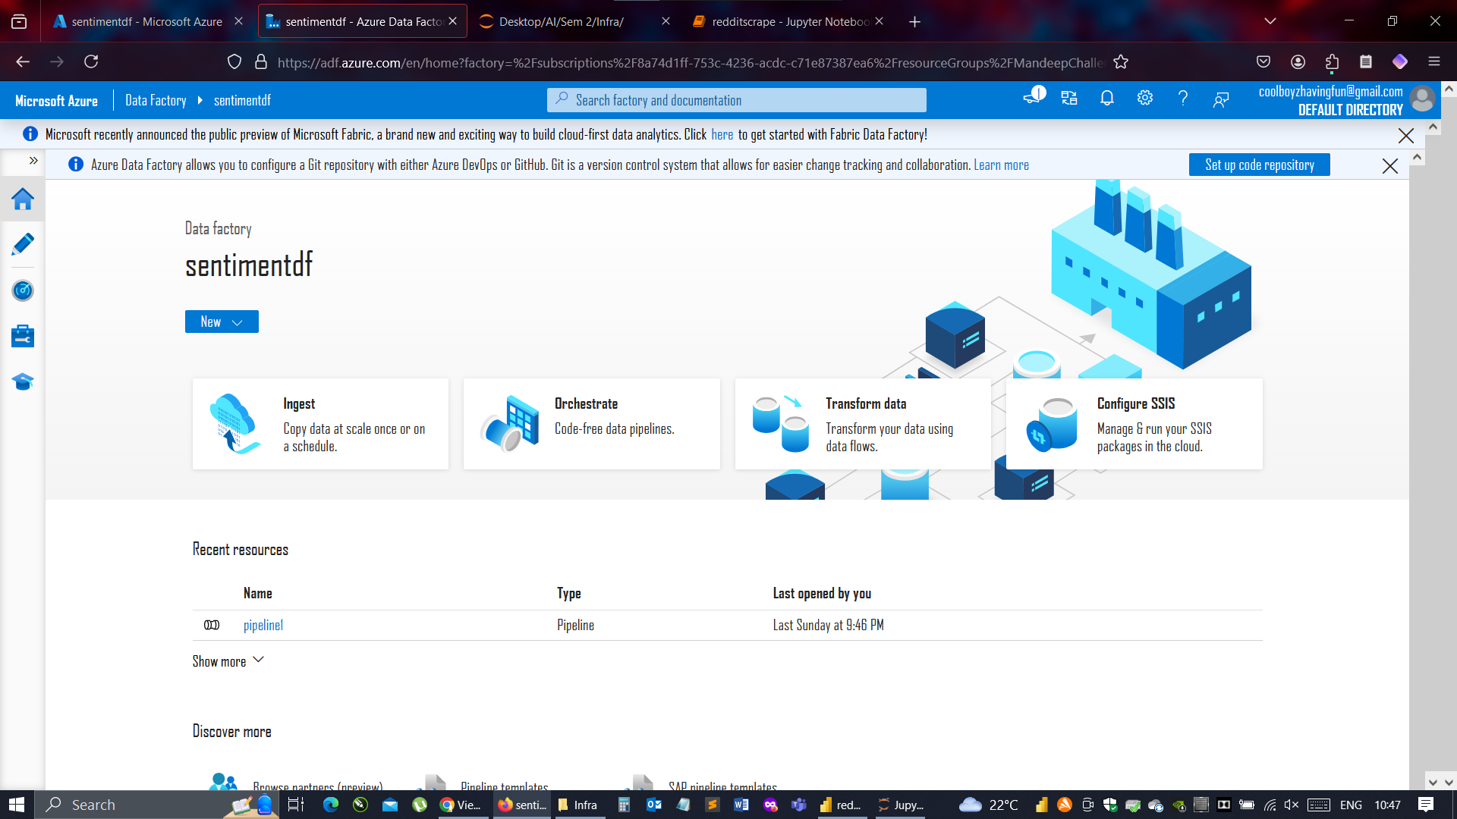
Screenshot of the pipeline to feed the sql database

Slide 20
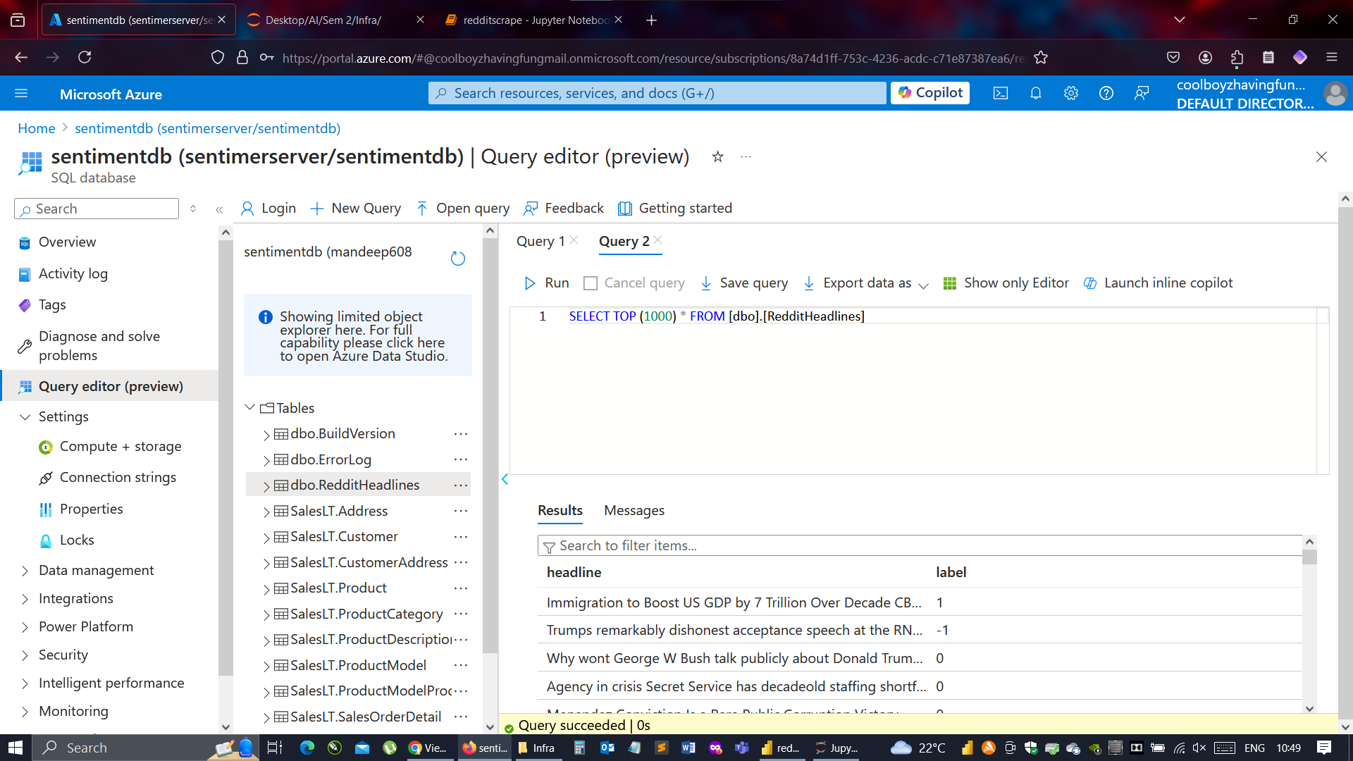
Screenshot of the sql query editor (creation of redditheadlines table and running a sample query to see if data is being displayed properly or not)

Slide 21
#6. Data Visualisation
Data Visualization Tool: PowerBI
Steps:
Connect PowerBI to the SQL Server database.
Import the ingested data.
Create visualizations and dashboards.

Slide 22
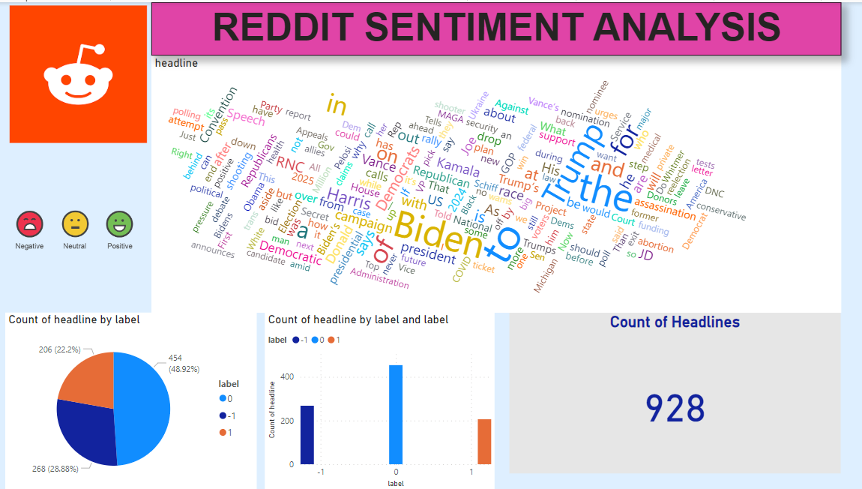
Screenshot of the dashboard created in PowerBI

Slide 23
#7. Github Link
Code Repository GitHub Link: https://github.com/mandeep609/RedditSentimentAnalysis

Slide 24
#8. Conclusion
To conclude, in this project we utilized Azure's cloud capabilities and data processing tools to build a sentiment analysis pipeline. The integration of ADF, SQL Server, and PowerBI facilitated data ingestion, management, and visualization.

